Slide 1
Analyzing and Predicting Successful Kickstarter Projects
Feras Alshaheen

Slide 2
Outline
1
2
3
4
5
Analysis and Findings
Modeling and Prediction Accuracy
Business Objective
Data Understanding
Summary

Slide 3
Business Objective
Analyzing success factors for projects on Kickstarter
Predicting future projects successes or failures

Slide 4
Data Understanding
Data consists of 378,661 records and 14 features.
Main features in the data:
Number of Backers
Requested Fund
Project Category
Expected Number of Days for Completion
Target ➔ project state

Slide 5
Analysis and Findings
General findings about projects that succussed
They have 265 backers on average.
Their required fund is around 10,000$ on average
They are usually completed within month
36% of successful project are under music and film categories

Slide 6
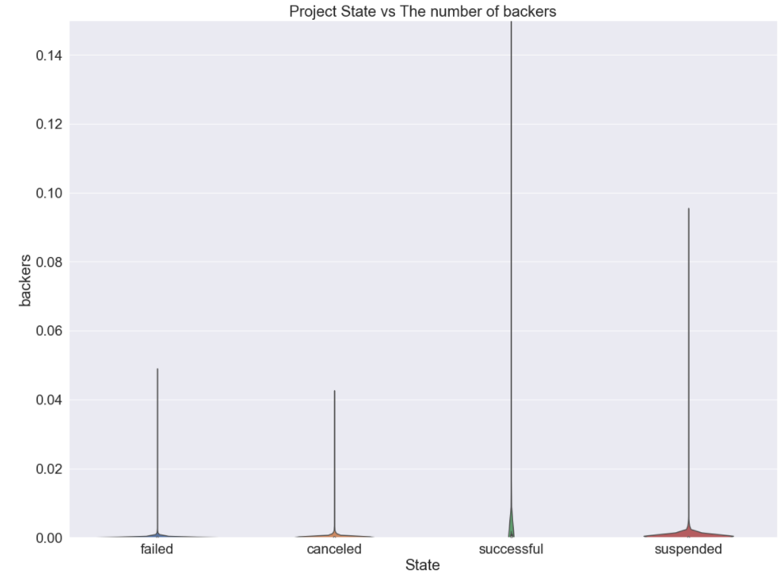
Project State Vs Number of Backers

Slide 7
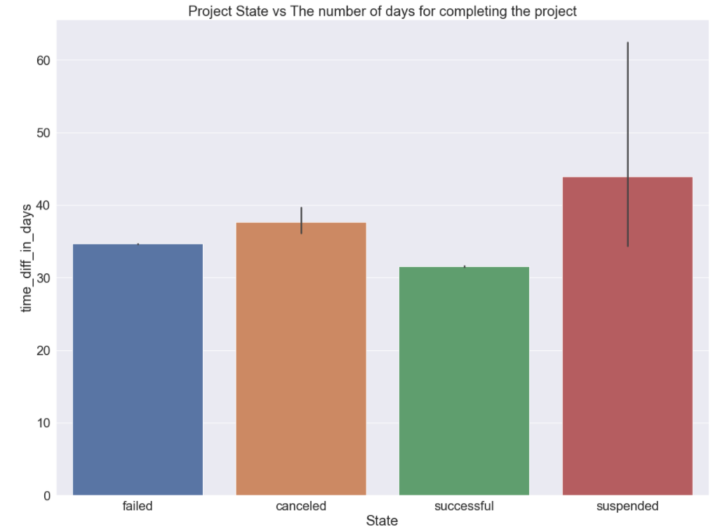
Project State Vs Time for Completion

Slide 8
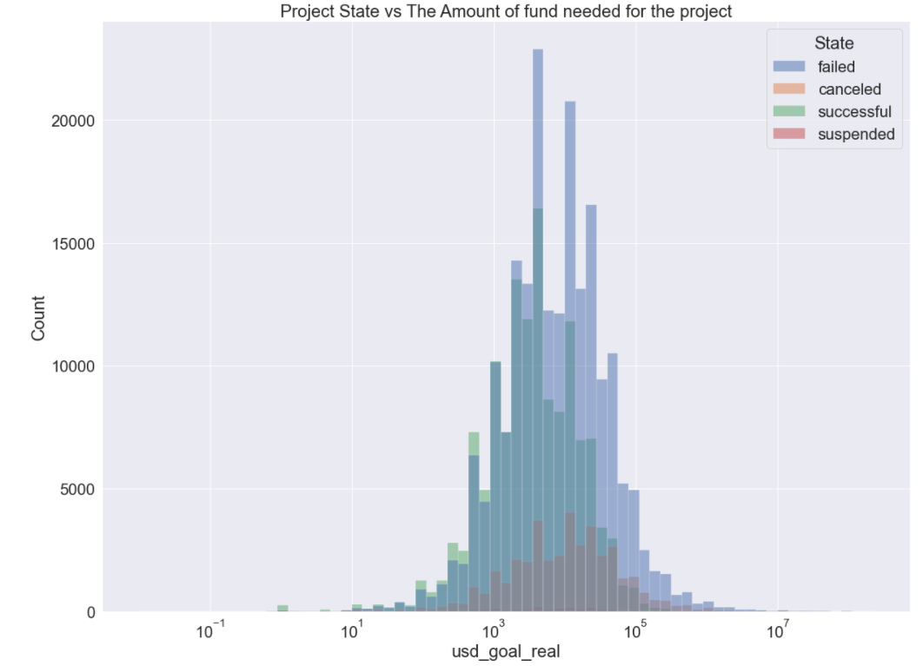
Project State Vs Amount of Requested Fund

Slide 9
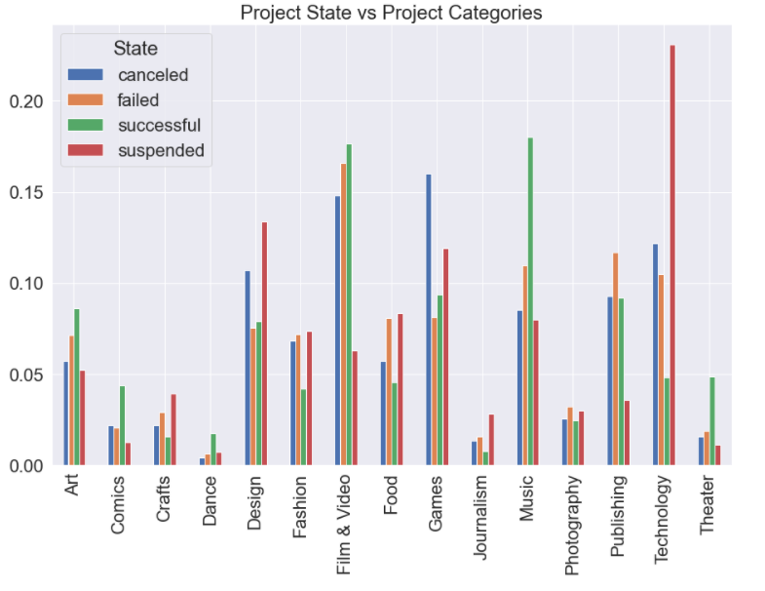
Project State Vs Project Category

Slide 10
Modeling and Prediction Accuracy
F1 Score | Recall | Precision | Accuracy | Model Type
0.860 | 0.861 | 0.859 | 0.901 | Decision Tree
0.546 | 0.3761 | 0.998 | 0.413 | GaussianNB

Slide 11
Summary
The main features that contribute towards project success are: amount of requested fund, project category, number of backers, and completion time.
Predicting the project state with 90% accuracy.

Slide 12
Thank you

